Slide 1
A Compiler for the Front End: Intro to Elm
If you brought a laptop, and it has npm installed, you can try this right now
npm install -g elm
Try this too. At the least, it has many links to Elm:
git clone https://github.com/atom-box/MKE.git
WiFi:
The WiFi for the code camp is
SSID - UWMVisitor
Password - panthers18

Slide 2
Social Media:
Twitter: @MKECodeCamp
I don’t have any pictures of me speaking.
Much appreciated if I could get some pics of me speaking: twitter@mistergenest
WiFi:
The WiFi for the code camp is
SSID - UWMVisitor
Password - panthers18

Slide 3


Slide 4
summary
Elm is very fast and very small when compared with React, Angular, Ember, etc.
Elm is a programming language that compiles to JavaScript.
It is known for its friendly error messages, helping you find issues quickly and refactor large projects with confidence.
It has static types.
Elm is purely functional.

Slide 6
What was your first programming language?
What is your language now?

Slide 7


Slide 8
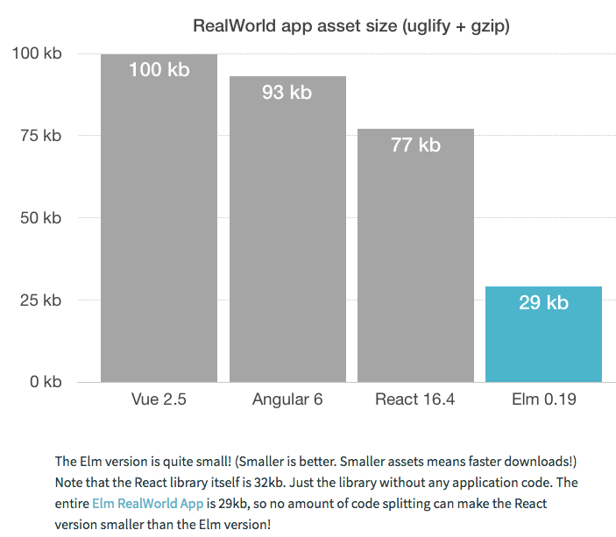

Slide 9
Elm is a compiled language.
It can compile to .js or .html

Slide 10


Slide 11
Language | Typing
Kotlin, Java | static
Elm | static
C++ | static
Javascript | dynamic
Python | dynamic
Typescript(MS) | dynamic
Elixir | dynamic

Slide 12
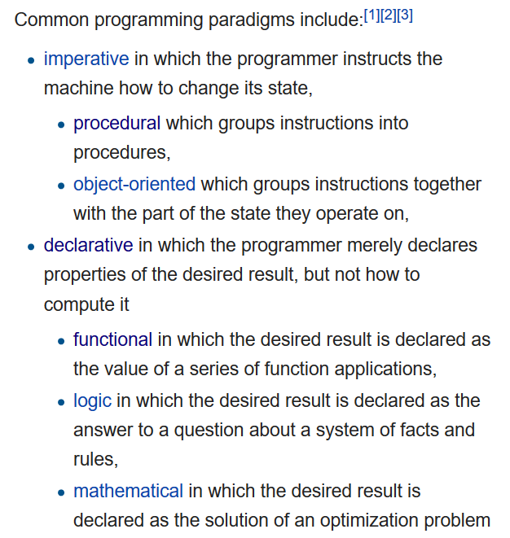

Slide 13
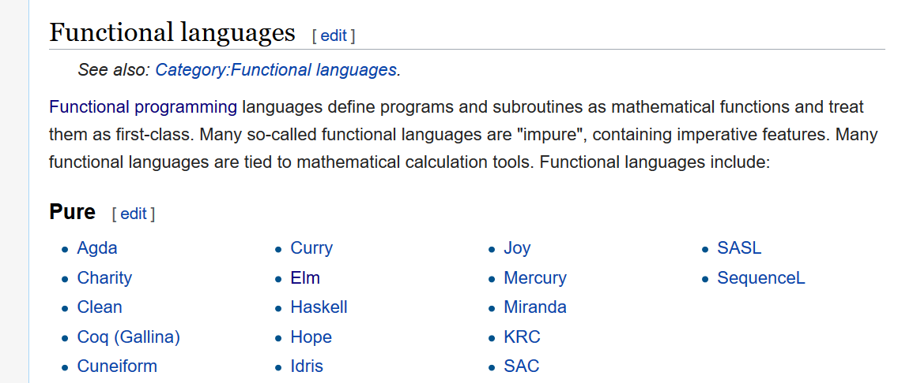

Slide 14
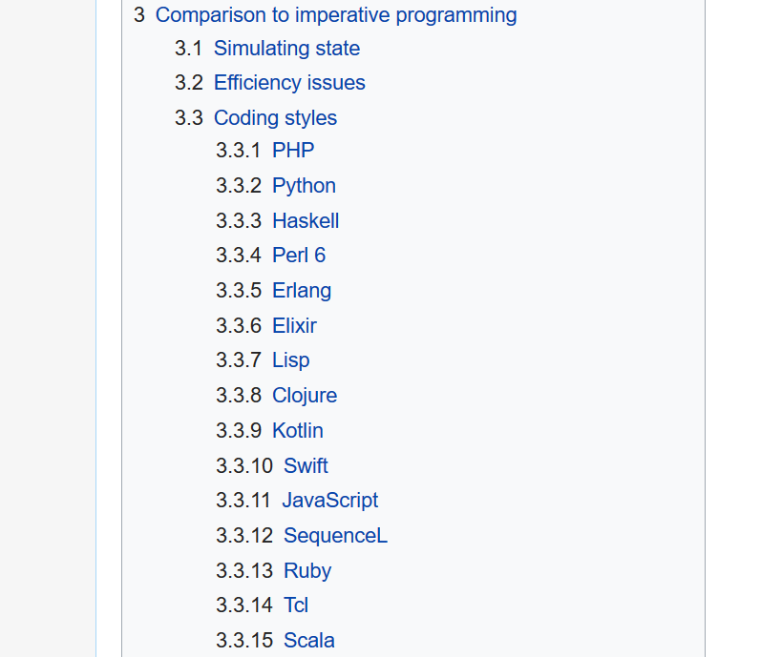

Slide 15


Slide 16


Slide 17
summary
Elm is very fast and very small when compared with React, Angular, Ember, etc.
Elm is a programming language that compiles to JavaScript.
It is known for its friendly error messages, helping you find issues quickly and refactor large projects with confidence.
It has static types.
Elm is purely functional.

Slide 18

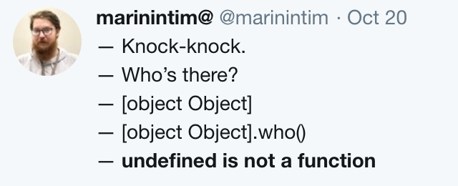

Slide 19
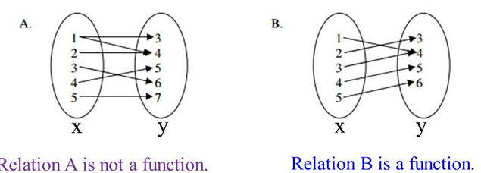

Slide 20
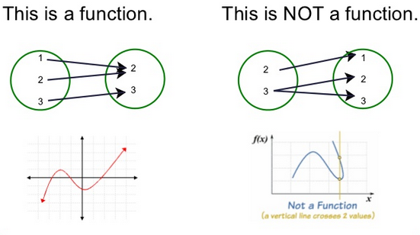

Slide 21

In ES6 there is a new keyword called const. This means that once a variable is set, it cannot be reset:
const a = 1; a = 2; // error.
const a = { x: 1, y: 2 }; a.x = 2; // NO ERROR! a = {}; // this will throw a TypeError
JS trying to do Immutability

Slide 22
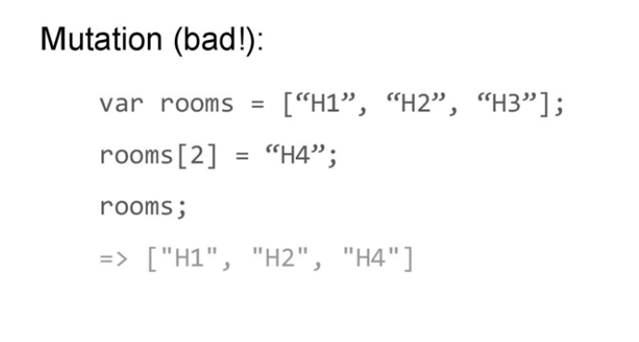
.
Javascript

Slide 23
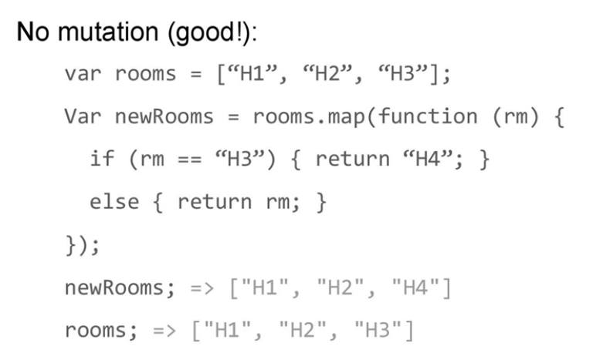
.
Elm:

Slide 24
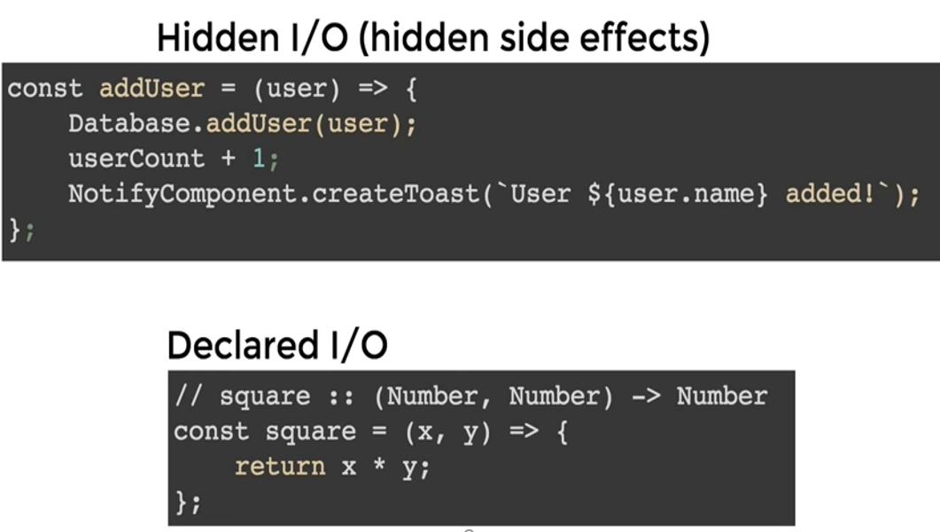
.
What about side effects?

Slide 25


Slide 26


Slide 27


Slide 28
“It took a little time to get used to Elm, especially for OO-raised people like me and most of my team.
But it eventually paid off.
Once you’ve understood the basic principles, you realize that coding in the browser can actually be productive, safe, and even fun.”
-Remi Van Keisbelck

Slide 29
“Elm is really bullet proof, it’s not fake advertisement. We have had no runtime errors, as promised. Refactoring is easy, with the compiler telling you just about everything. And yes, really, when it compiles, it works ! Apart from the quite slow 0.18 compiler (fixed in 0.19), it’s really amazing.” –
-Remi Van Keisbelck

Slide 30


Slide 31
What is it like trying to introduce something new
at your place of work?

Slide 32


Slide 33
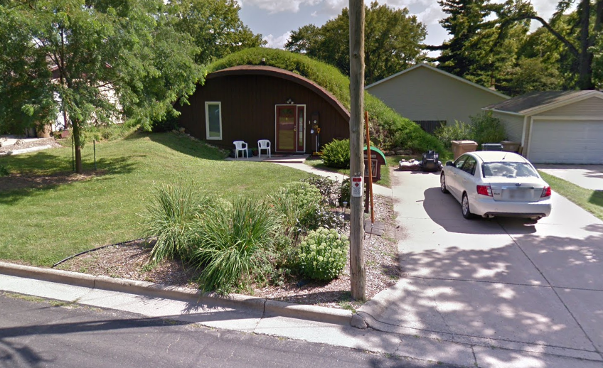

Slide 34
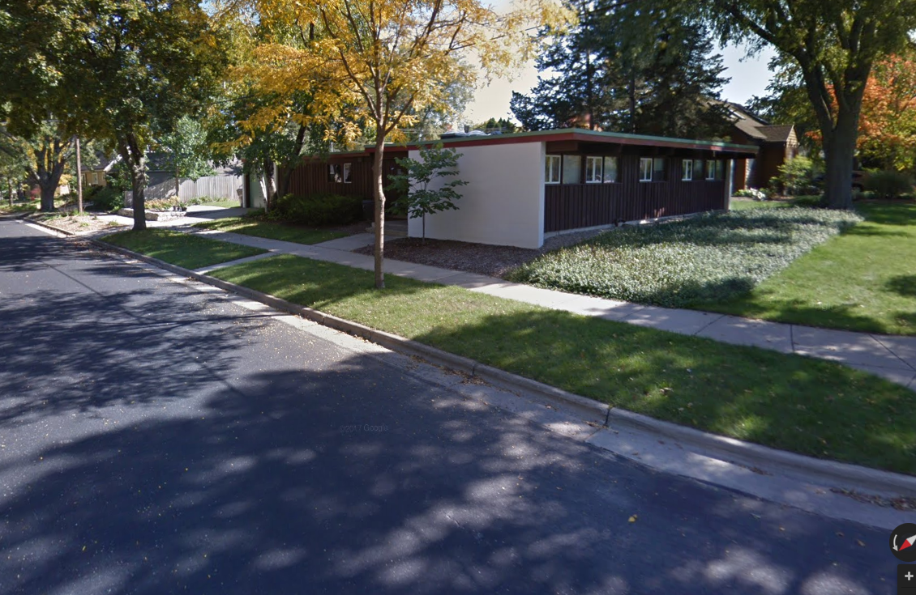

Slide 35
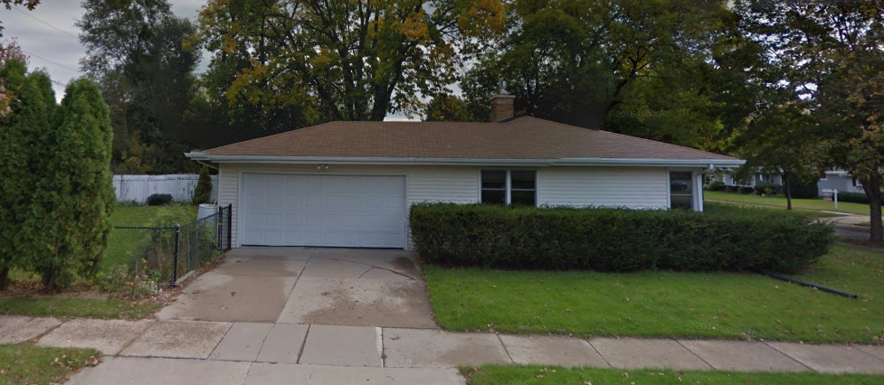

Slide 36


Slide 37
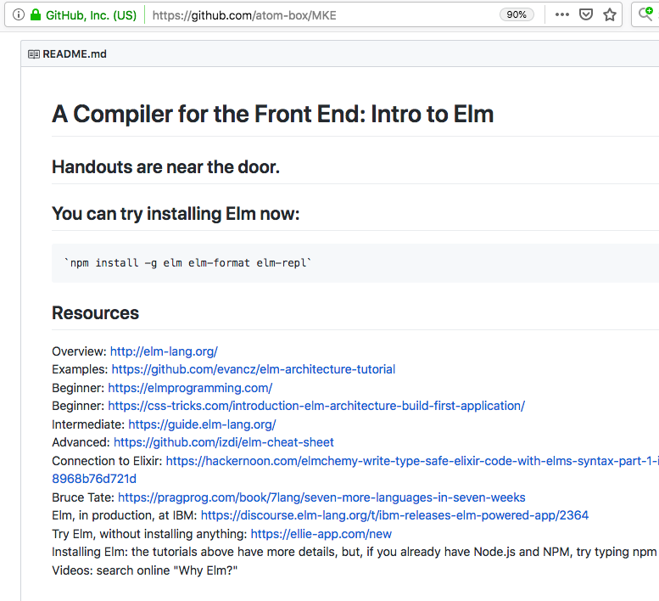

Slide 39
summary
Elm is very fast and very small when compared with React, Angular, Ember, etc.
Elm is a programming language that compiles to JavaScript.
It is known for its friendly error messages, helping you find issues quickly and refactor large projects with confidence.
It has static types.
Elm is purely functional.

Slide 40



Slide 41
Please clean up your own
trash in the rooms today.

Slide 42
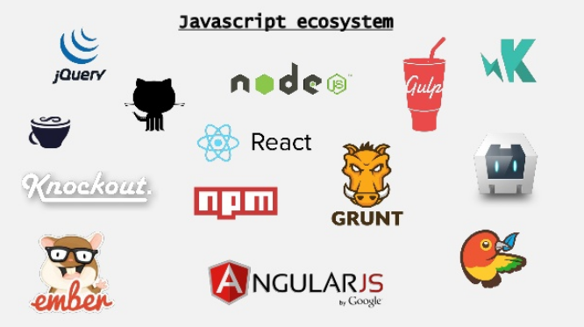

Slide 43


Slide 44



Slide 45



